Slide 1
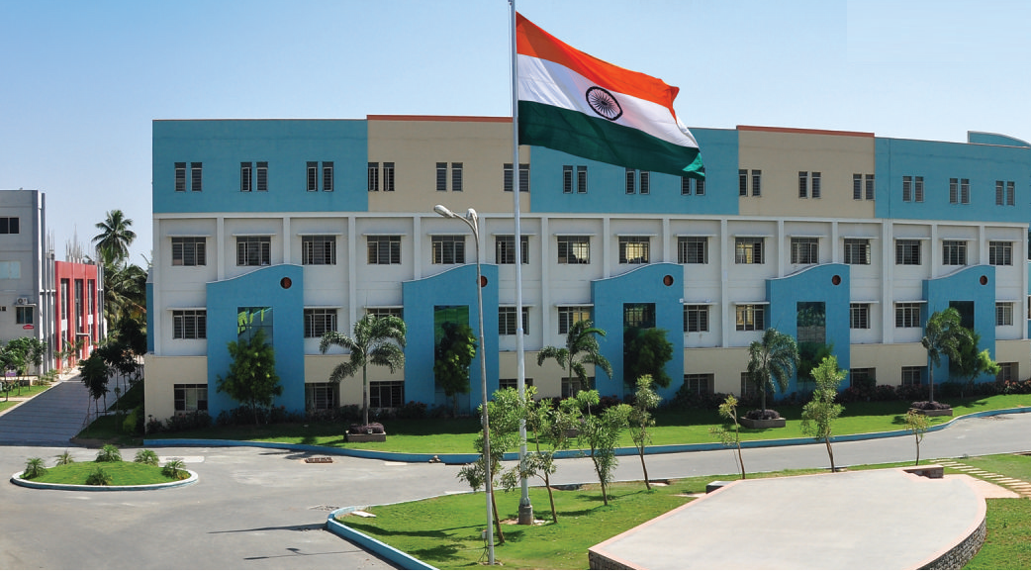
SRI ESHWAR COLLEGE OF ENGINEERING academic year: 2017-18 department: civil engineering
FINAL YEAR PROJECT REVIEW – 1
Date of review: 24-04-17

Slide 2
PLANNING , ANALYSIS AND DESIGN OF RUNWAY AND TERMINAL BUILDING AT COIMBATORE
Batch Members
1.HARI KRISHNA.M
2. BALA SURYA.G
3. PRAVEEN.N
4. BRINTHA.C
Guide Name:
Mr.YUVARAJ, M.E.,
Asst.Prof/Civil Dept.
.

Slide 3
Presentation Outline
Abstract
Introduction
Objective
Literature Survey
Methodology
Plan - AUTOCADD
Analysis - STAAD.PRO
Design -STAAD.PRO & MANUAL DESIGN
Results and discussion
Conclusion

Slide 4
ABSTRACT OF THE PROJECT
The proposed terminal building consists of G+1
( exclusion of roof deck) with all the necessary facilities required. It is planned to withstand large amount of travelers.
The terminal building has been designed keeping the minimum requirement of standards.

Slide 5
INTRODUCTION
An airport terminal is a building at an airport where passengers transfer between ground transportation and the facilities that allow them to board and disembark from aircraft.
Within the terminal, passengers purchase tickets, transfer their luggage, and go through security. The buildings that provide access to the airplanes (via gates) are typically called concourses. However, the terms "terminal" and "concourse" are sometimes used interchangeably, depending on the configuration of the airport

Slide 6
OBJECTIVE
To plan an airport terminal building at the Coimbatore international airport.
To analyse the structural components using Staad.Pro
To design all the structural and non structural components of the terminal building by using of correct standards.
Plan - AUTOCAD
Analysis - STAAD.PRO
Design -Manual
Detailing- AUTOCAD

Slide 7
Literature Survey (Cont.d)
JOURNAL | International Journal of Innovative Research in Science, Engineering and Technology
TITLE | Evaluation of an Airport Terminal Building for Developing a Measurement of Passenger Satisfaction Standard
AUTHOR(S) | Hasan Ş. Haştemoğlu , İlker Erkan
INFERENCE | : The main idea of the study is to determine the standards which will be used to evaluate Airport Terminal Buildings, and to generate a standard to collect departing passenger satisfaction, to identify root causes of problematic issues raising dissatisfaction level of passengers, and to formulate necessary solutions for decreasing or limiting the dissatisfaction level(s). In this study, it is aimed to construct an evaluation standard which is based on passenger perception for either international or national passenger terminals which have inadequate data, and to obtain initial data from a generalizable sample group

Slide 8
Literature Survey (Cont.d)
JOURNAL | International Journal of Innovative Research in Science, Engineering and Technology
TITLE | A literature review of flexible development of airport terminals
AUTHOR(S) | LILIANA MAGALHAES,VASCO REIS,ROSARIO
INFERENCE | The review reveals that research in airport terminal flexibility is still in its early stages. A consensual definition has yet to be defined and no robust framework for deploying flexibility has been defined. We propose a new definition of flexible development. Furthermore, flexibility has been studied essentially in the context of expansion.

Slide 9
Methodology
Topic selection
Literature review
Drafting plan
Analyzing
Designing
Results and discussion
Conclusion

Slide 10
Need for study
The rate of passengers travelling from the Coimbatore international airport is increasing every year.
But the terminal building in it is designed based on the rate of passengers at the time of its construction.
Hence we are designing a more compactible and larger airport to hold a large number of people.

Slide 11
Building features
Total area : 5400sq. m
Number of floors : GF+1
Type of construction : RCC framed
building
4.Materials : M30 grade of
concrete & Fe415
HYSD bars
5. Floor height : 7.5m

Slide 12
Project schedule
 | July |  |  |  | August |  |  |  | September |  |  |  | October
Weeks | 1 | 2 | 3 | 4 | 1 | 2 | 3 | 4 | 1 | 2 | 3 | 4 | 1 | 2 | 3 | 4
Topic selection
Collection of Data
Planning
Analysis
Designing
Report Preparation

Slide 13
THANK YOU

